Slide 1
Memory
Vikas Rokade
19-Dec-2018

Slide 2
Table Of Contents :
Different types of memory
History of Memory
EEPROM
Flash Memory
SRAM and DRAM

Slide 3
Memory
Memory structures are crucial in digital design.
– ROM, PROM, EPROM, RAM, SRAM, (S)DRAM, RDRAM,..
• All memory structures have an address bus and a data bus
– Possibly other control signals to control output etc.
• E.g. 4 Bit Address bus with 5 Bit Data Bus

Slide 4
memory classification
Volatile memories
Lose data when power down

Slide 5
Types of ROM

Slide 6
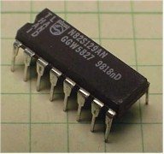
Types of ROM: PROM
Modified/Programmed only once by a user.
PROM is a way of allowing a user to tailor a microcode program using a special machine called a PROM programmer .
This machine supplies an electrical current to specific cells in the ROM that effectively blows a fuse in them.
The process is known as burning the PROM

Slide 7
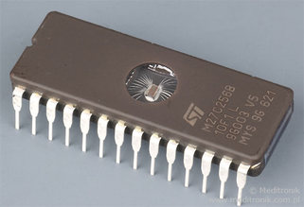
Types of ROM: EPROM
EPROM chips can be rewritten many times
EPROM is erased using Ultra violet rays.
EPROM chip has to be removed from the computer circuit to erase and reprogram the computer BIOS
An EPROM eraser is not selective, it will erase the entire EPROM
To rewrite an EPROM, you must erase it first

Slide 8
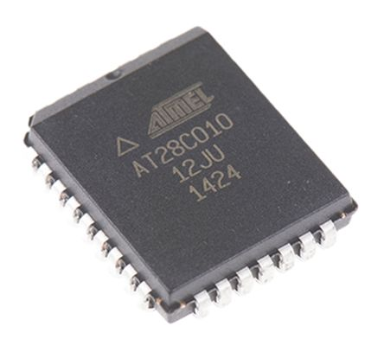
Types of ROM: EEPROM
EEPROM chip can be erased and reprogrammed in the computer circuit to erase and reprogram the content of computer BIOS.
EEPROM can be erased in the circuit by applying the special programming signals

Slide 9
Types of EEPROM: Parallel EEPROM
The serial access represents 90 percent of the overall EEPROM market, and parallel EEPROMs about 10 percent. Parallel
devices are available in higher densities (≥256Kbit), are generally faster, offer high endurance and reliability,
and are found mostly in the military market. They are pin compatible with EPROMs
and flash memory devices.

Slide 10
Types of EEPROM: Series EEPROM
Serial EEPROMs are less dense (typically from 256 bit to 256Kbit) and are slower than parallel
devices.
They are much cheaper and used in more “commodity” applications.

Slide 11
What is Flash Memory?
A type of Non-Volatile memory
A specific type of EEPROM (Electrically Erasable Read Only Programmable Memory)
Solid-State Memory
It can be read/written and it doesn’t need POWER for data retention.
It’s fast.
It’s durable

Slide 12
Types of Flash Memory : NAND Flash
NAND type is primarily used in main memory, memory cards, USB flash drives, solid-state drives, and similar products, for general storage and transfer of data
does not allow to randomly access any location in the memory.
Instead, there are groups of bytes called pages to be requested. In case of read the requested page is internally transferred from flash matrix into the page register and only from there page data can be accessed in a serial-alike way byte by byte starting from the byte at indicated location within the page.
The address within the active page can be freely changed to read other bytes from the given memory page. Changing page address requires to re-execute the matrix read command.
Pages are grouped into blocks which are the smallest area than can be erased, the single page is the smallest region that can be programmed. Blocks are organized in planes and planes in logic units (LUN).

Slide 13
Types of Flash Memory : NAND Flash
NAND Flash has a much smaller cell size
much higher write and erase speeds compared to NOR Flash.
Disadvantages include the slower read speed and an I/O mapped type or indirect interface, which is more complicated
does not allow random access.
It is important to note that code execution from NAND Flash is achieved by shadowing the contents to a RAM, which is different than code execution directly from NOR Flash.
NAND Flash memories are available in much higher densities compared to NOR Flash owing primarily to its lower cost per bit. NAND Flash memories typically comes in capacities of 1Gb to 16Gb. NOR Flash memories range in density from 64Mb to 2Gb. Because of its higher density, NAND Flash is used mainly for data storage applications.

Slide 14
Types of Flash Memory : NAND Flash

Slide 15
Types of Flash Memory : NOR Flash
The NOR Flash architecture provides enough address lines to map the entire memory range.
This gives the advantage of random access and short read times, which makes it ideal for code execution.
Disadvantages include larger cell size resulting in a higher cost per bit and slower write and erase speeds

Slide 16
Types of Flash Memory : NOR Flash
NAND or NOR flash memory is also often used to store configuration data in
numerous digital products, a task previously made possible by EEPROMs or battery-powered static RAM

Slide 17
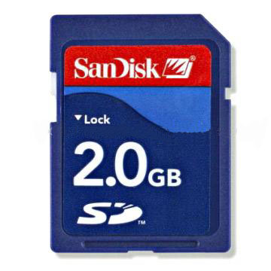
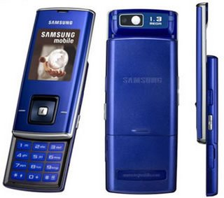
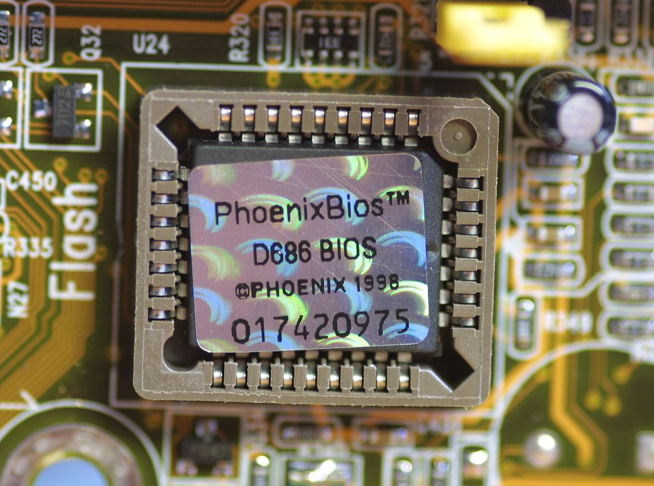
Applications of flash memory

Slide 18
RAM

Slide 19
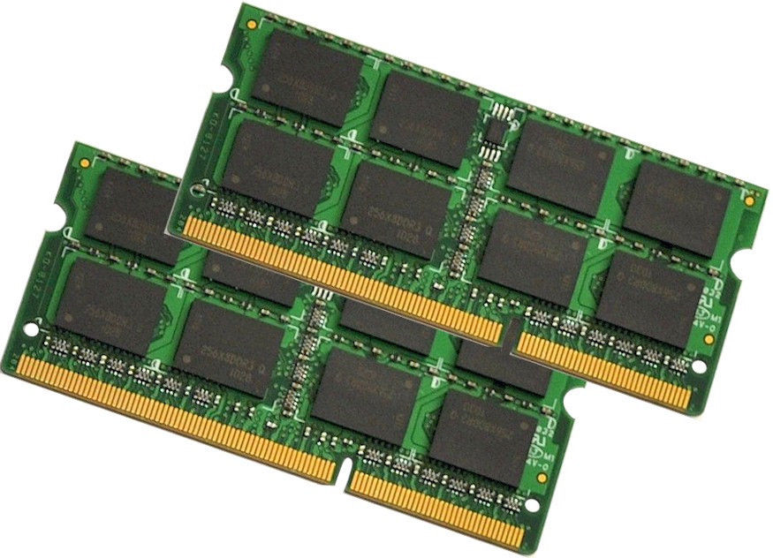
RAM

Slide 20
Types of RAM
RAM - Overview
• SRAM (static)
– Formed from internal latches - 6 transistors per bit. – Latch will store information as long as power supplied. – Inherently synchronous. – Integrable. – Fast , 12 ns access time direct from Farnell – Fast, 4 ns access time in ECL from Cypress – On chip caches, off chip caches, HD caches,...
2525
RAM - Overview
• DRAM (dynamic)
– Storage of charge on a capacitor gated by a transistor – 1 ish transistor per bit. – High packing density, large cheap memory, – Cheap + economies of scale = very cheap. Commodity item. – Less integrable – Seriously faster than hard disk, 70 ns direct from Farnell – Main memory – These days most DRAM is also synchronous SDRAM

Slide 21
Memory Product Comparison
 | Serial EEPROM | Parallel EEPROM | OTP EPROM | Serial Flash | Parallel Flash | Serial SRAM | Serial NVSRAM | Serial EERAM
Clock Frequency | 0.4 - 20 MHz | 70 ns | 45 ns | 20 - 104 MHz | 45 - 70 ns | 16 - 20 MHz | 16 - 20 MHz | 1 MHz
Cost/Bit | High | High | High | Low | Low | Medium | Medium | Low
Read Times | Medium | Fast | Fast | Medium | Fast | Medium | Medium | Medium
Write Times | Medium | Fast | NA | Medium | Fast | Instantaneous | Instantaneous | Instantaneous
Pin Count | 8 pins | 28 and 32 pins | 28+ pins | 8 pins | 32 and 48 pins | 8 pins | 8 pins | 8 pins
Data Retention | 200+ Years | 10 Years | 10 Years | 100+ Years | 100+ Years | Volatile | 20+ Years(with battery) | 200+ Years
Typ. Standby Current | 1 µA | 200 µA | 100 µA | ~15 µA | ~30 µA | ~4 µA | ~4 µA | ~40 µA
Voltage | 1.7 V - 5.5V | 2.7V, 5V | 2.7V, 5V | 1.65V - 1.95V, 2.7V - 3.6V, 2.3V - 3.6V | 1.65V - 1.95V, 2.7V - 3.6V, 4.5V - 5.5V | 1.65V - 1.95V, 2.5V - 5.5V | 2.5V - 5.5V | 2.7V - 3.6V, 4.5V - 5.5V
Temperature | -40°C to +125°C | -55°C to +125°C | -55°C to +125°C | -40°C to +105°C | -40°C to +85°C | -40°C to +85°C | -40°C to +85°C | -40°C to +85°C

Slide 22
As an embedded engineer

Slide 24
Thank You
www.kpit.com

